Slide 1
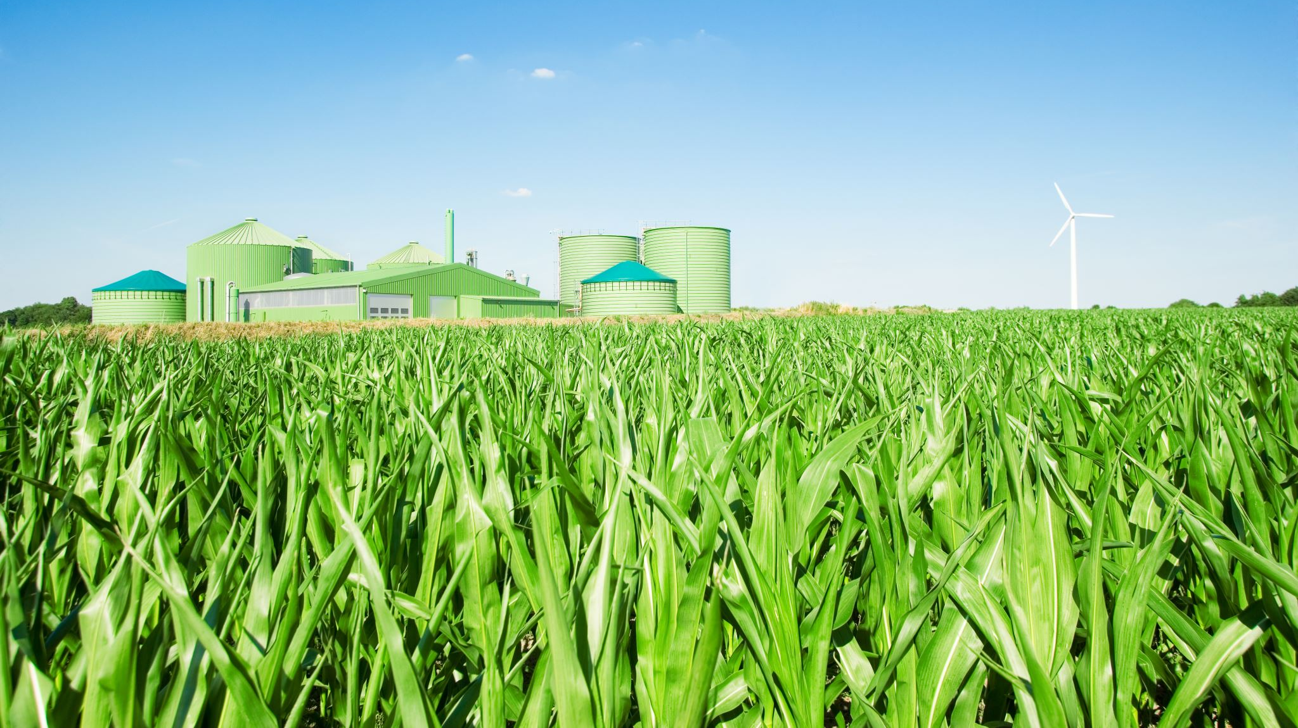
Global Agricultural Production and Population Analysis
Project 1
Corey Holton, Elena Gehle, Domenic Guerrero, and Roberta Chandler

Slide 2

Overview
1. Introduction
Background: This project analyzes global agricultural production relative to population data over time. It uses Python to process data on agricultural production by category, and country, as well as global and continental population data. The goal is to visualize trends in food production and relationships between food production and population growth.
Purpose: For a better understanding of the relationship between agricultural production and population.
Objective: To learn and analyze the global agricultural production and how it has changed relative to population over time.
2. Research Questions
Key Questions:
How has the production of major agricultural products (e.g., meat, vegetables, grains) evolved over time?
How does agricultural production vary across different countries and continents?
What trends can be observed in the relationship between agricultural production and population growth?

Slide 3
Data collection, cleanup, and exploration
Following the selection of the project’s focus, a comprehensive search was conducted to identify suitable datasets on agricultural production and global population. After acquiring the relevant datasets, they were imported into a notebook for initial review. It was quickly observed that the agricultural dataset contained an abundance of data, while the population dataset lacked complete records for all years. To address this gap, an additional population dataset was sourced and merged with the initial data to ensure consistency in the time frames.
The data underwent a thorough cleanup process, which involved removing non-essential columns and restructuring it to align with the analysis objectives. To simplify visualization and manage the extensive data, agricultural production was aggregated at the continental level, and items were categorized according to predefined classifications. It was noted that meat production was reported in a different unit (An, representing individual animals) compared to other data, which was primarily in metric tonnes. Additionally, egg production was reported in metric tonnes and An, resulting in unexpectedly high values compared to many grains—an observation that, took some time to discover the duplicate counts that accounted for inaccurate analysis. The final dataset was transformed into a time series format, facilitating statistical analysis and visualizations to highlight key trends.

Slide 4

Data collection, cleanup, and exploration
Aggregation: Data was aggregated to assess production totals by category and continent, including averages, maximums, minimums, and sums. Additionally, top-producing items were identified at the country level to highlight significant contributors.
Correlation Analysis: Correlation coefficients (Pearson and Spearman) were calculated to examine the relationship between agricultural production and population growth, as well as correlations between different production categories within continents.
Comparison Analysis: Comparisons were made across continents and within countries to evaluate growth and decline in specific agricultural categories, revealing how production contributions vary over time.
Summary Statistics: Key statistical metrics, such as mean, median, and standard deviation, were used to summarize yearly production data, helping to identify trends per continent.
Time Series Analysis: Time series plots were used to visualize the interaction between population growth and agricultural production globally, and forecasting techniques like Prophet were considered to predict future production trends.
Sentiment Analysis: The impact of public perception on agricultural production was explored, particularly noting Europe’s decline in agricultural production, which aligns with negative sentiments toward environmental impacts associated with farming.

Slide 5

Approach to Achieving Project Goals
The project approach emphasized staying on task, maintaining diligence, and making consistent daily progress until all tasks were completed. Tasks were clearly outlined in detail, providing a structured roadmap for the work ahead.
To address the research questions, data preparation was the initial focus, ensuring the datasets were suitable for analysis. With the prepared datasets, various graphs were generated based on the questions posed. Observations from these visualizations sparked further data exploration, leading to deeper insights.
Subsequently, efforts were directed towards assembling the README file, which was completed efficiently. The final step involved creating an outline for the presentation and incorporating key graphs to guide the delivery of this segment, ensuring a comprehensive and cohesive presentation.

Slide 6
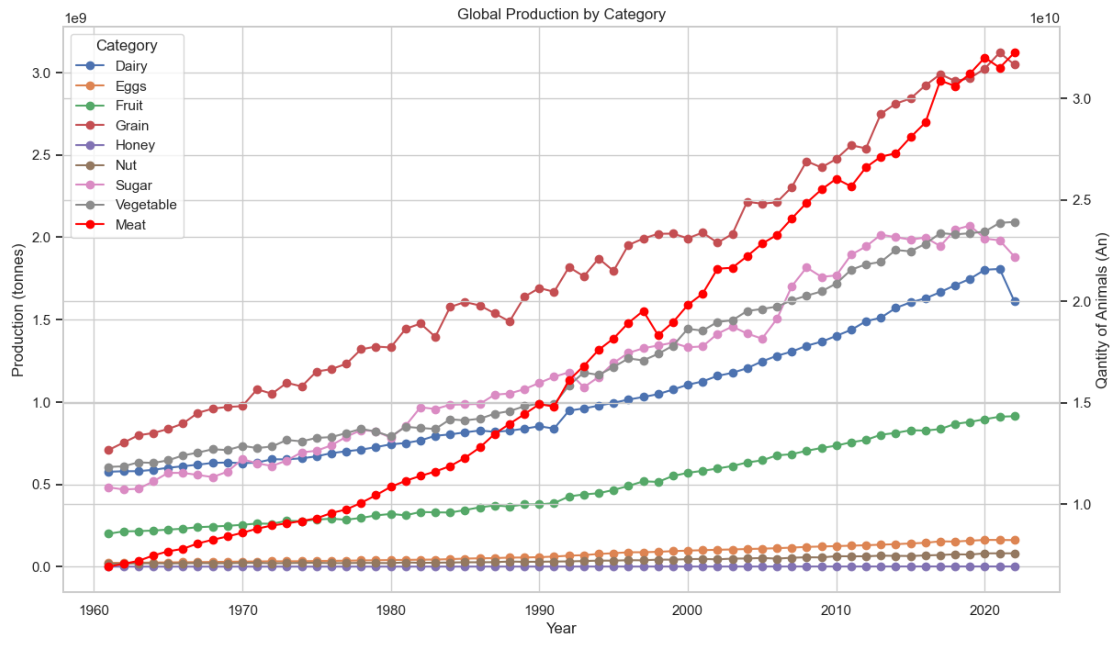
1. How has the production of major agricultural products (e.g., meat, vegetables, grains) evolved over time?
Key Findings:
Meat Production: Globally, meat production has shown the most significant increase among all agricultural products, experiencing the fastest and most extreme growth. This prompted further investigation to identify the underlying factors driving this expansion.
Grain and Vegetable Production: Grain production also increased, although at a slower rate compared to meat and similar to vegetables. This slower growth may be influenced by challenges such as land availability, crop rotation requirements, and climate variability affecting yield.
Minimal Growth in Other Categories: Other agricultural categories, such as nuts, showed relatively modest increases, reflecting potentially slower adoption of advanced farming techniques or limited arable land.

Slide 7
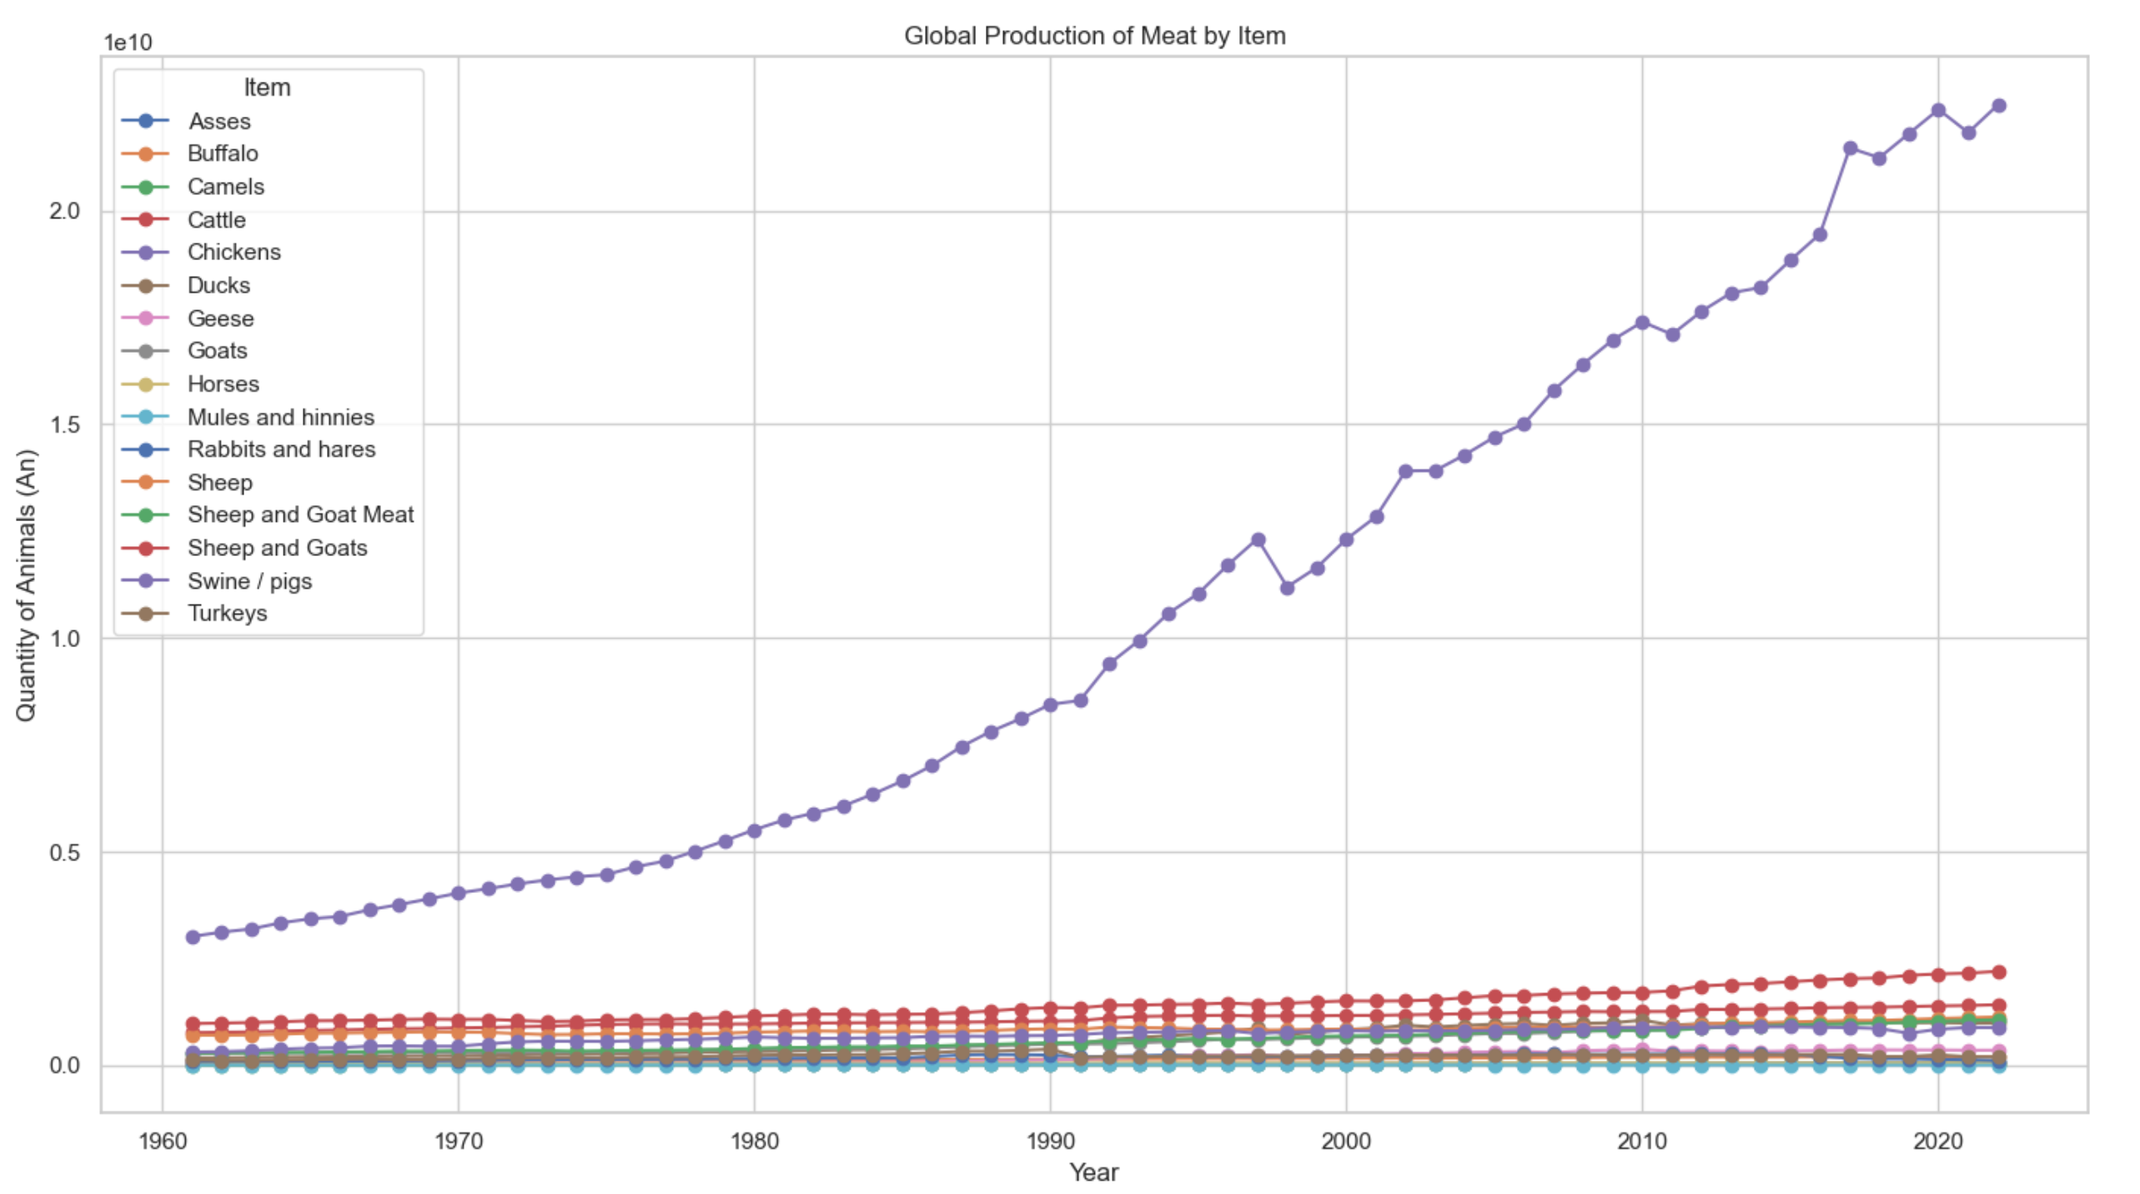
1. How has the production of major agricultural products (e.g., meat, vegetables, grains) evolved over time?
Detailed Observations:
Subsets within the meat category were further analyzed due to the high production values observed. Chicken production dwarfed all other meat production categories, showing nearly exponential growth, while other meats like beef and pork exhibited minimal growth. Sheep and goat production experienced slight increases, highlighting regional preferences and production challenges.

Slide 8
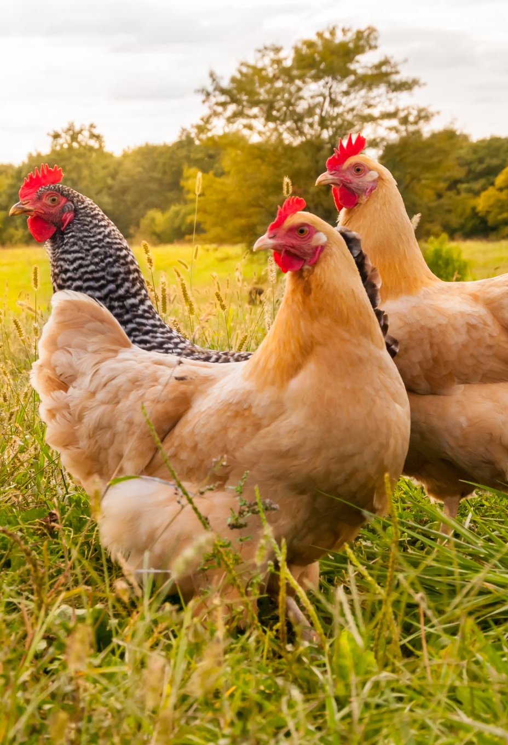
1. How has the production of major agricultural products (e.g., meat, vegetables, grains) evolved over time?
Implications:
The significant rise in chicken production suggests a shift in global consumption patterns, with potential implications for land use, feed supply chains, and environmental impact.
The modest growth in other food categories may signal constraints in agricultural innovation, regional differences in dietary preferences, or production limitations that could impact food security if not addressed.

Slide 9
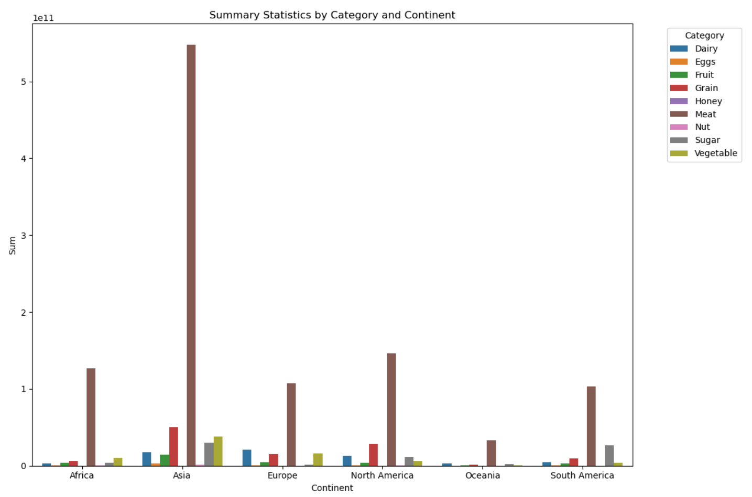
2. How does agricultural production vary across different countries and continents?
Key Findings:
Continental Variations: While meat was dominant across all continents, other agricultural outputs vary significantly. For example, North America had strong production in grains, particularly corn and soybeans, due to favorable climate conditions and advanced farming technologies. In contrast, Asia shows a diverse production landscape, with high outputs in grains like rice, and vegetables, driven by regional dietary preferences and intensive farming practices.
Country-Level Differences: When analyzing production at the country level, substantial variations become evident. For instance, Brazil and the United States are major producers of beef, while European countries show a preference for dairy and pork production. African countries demonstrate a diverse range of production, often driven by local needs and less mechanized farming methods, leading to lower overall outputs compared to more industrialized nations.
Production Concentration: A deeper breakdown of the data, focusing on the top five items within each agricultural category, reveals that production is highly concentrated in a few commodities. For instance, wheat, rice, and maize dominate grain production worldwide, while fruits and vegetables show more regional specialization, with tropical fruits prevalent in Latin America and Southeast Asia.

Slide 10
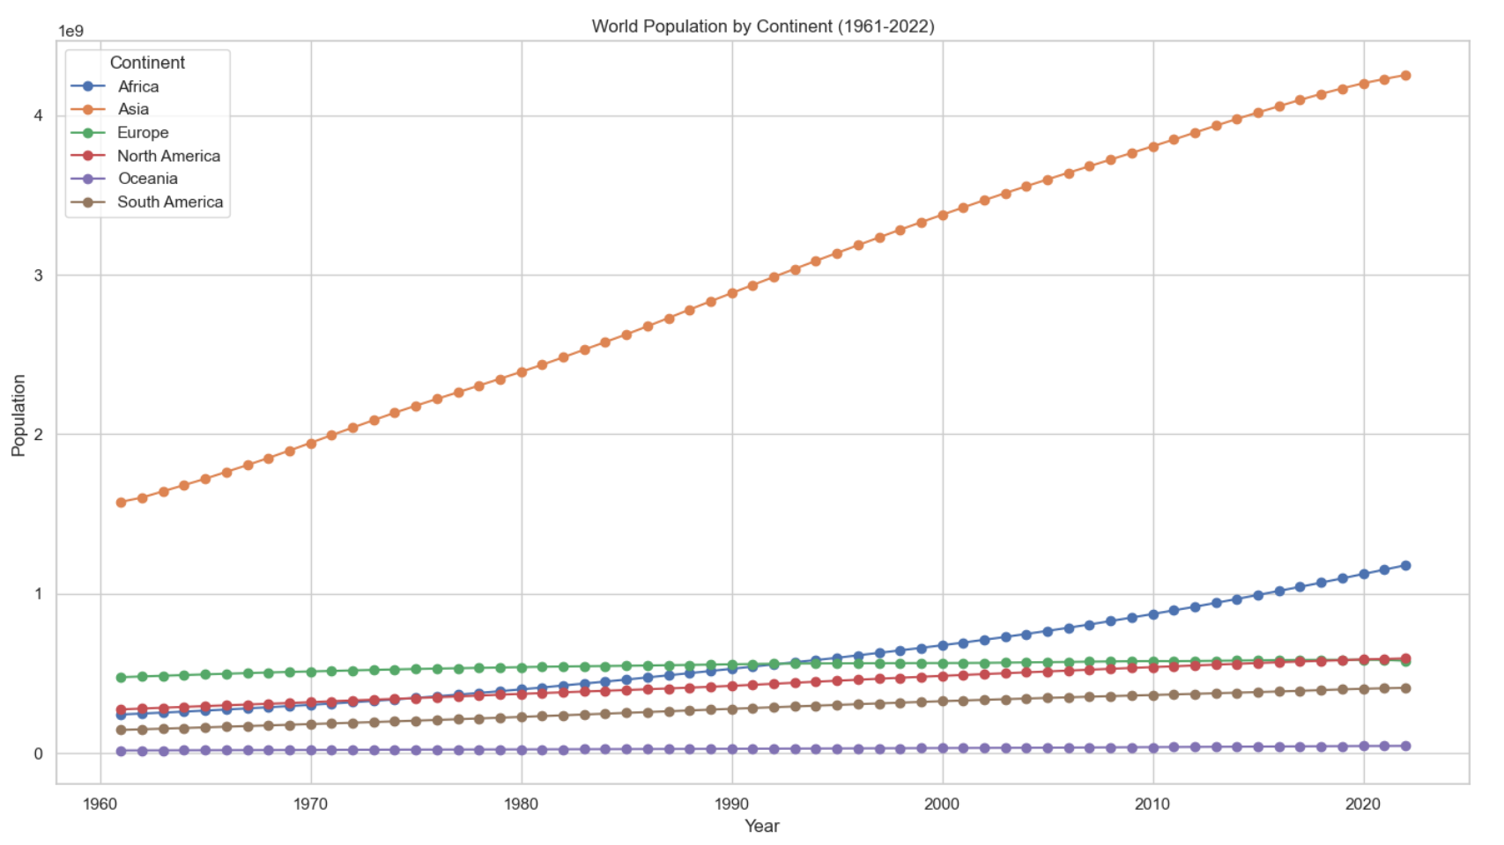
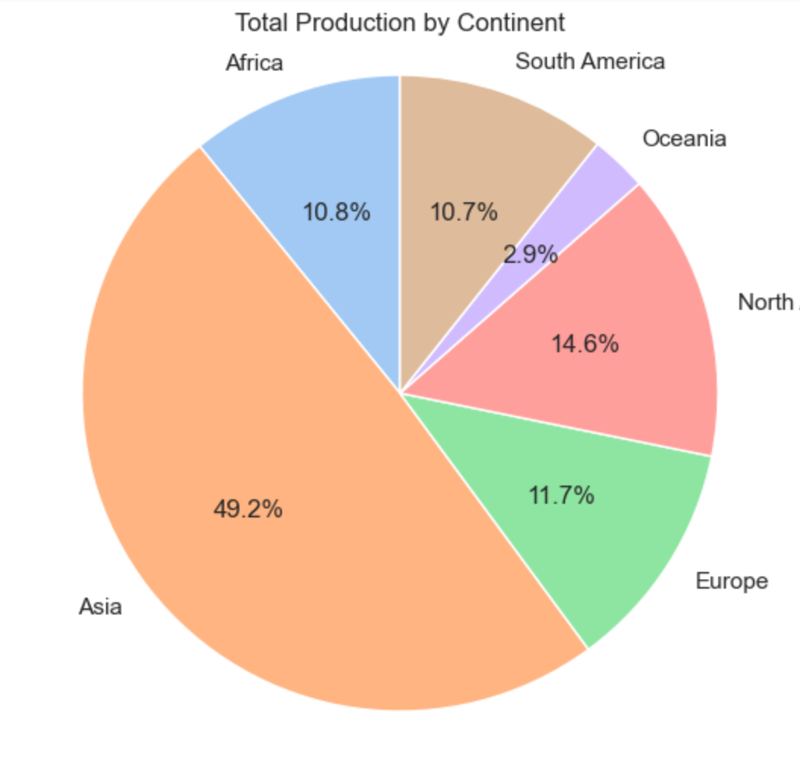
2. How does agricultural production vary across different countries and continents?
Implications:
The variations in agricultural production highlight the influence of regional climate, soil conditions, cultural dietary habits, and levels of technological advancement on food production patterns. Understanding these differences is essential for developing targeted agricultural policies and international trade strategies.
The concentration in specific commodities, particularly chicken and grains, points to potential vulnerabilities in the global food system, as shifts in demand, disease outbreaks, or climate impacts could disproportionately affect these key sectors.
Further research is recommended to explore the drivers behind these production patterns, including economic factors, policy impacts, and the role of international trade in shaping agricultural outputs across regions.
*Derived using sum of sums

Slide 11
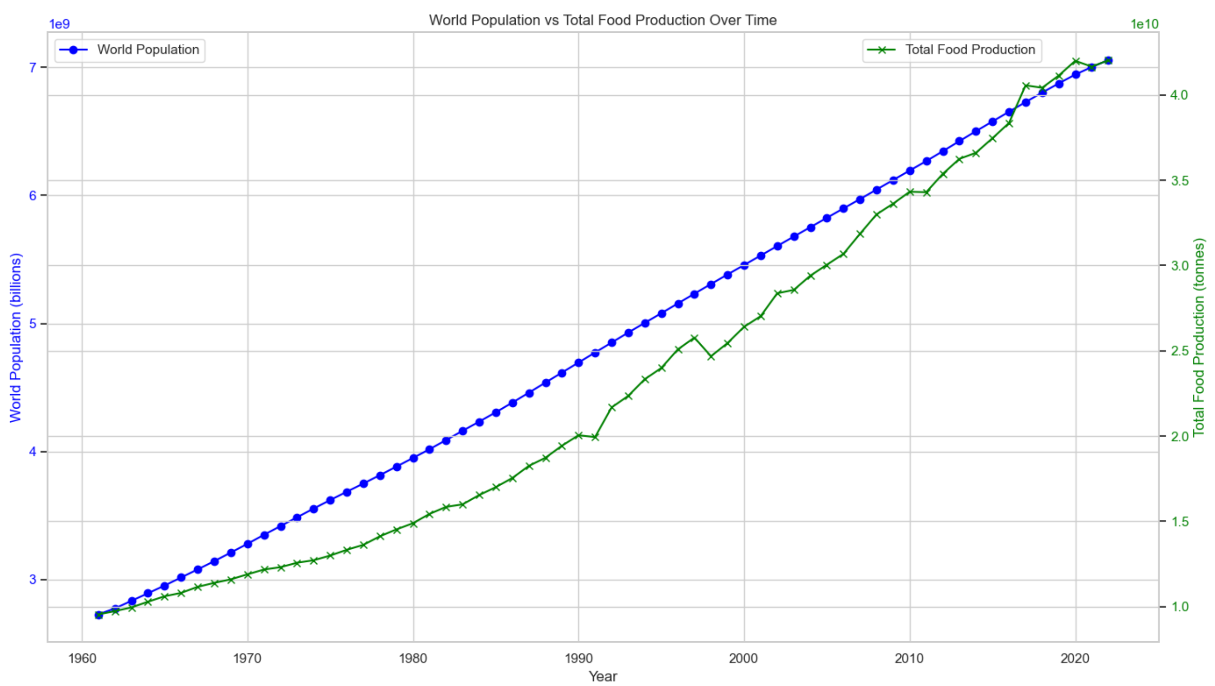
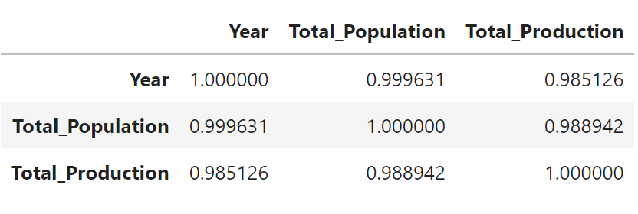
3. What trends can be observed in the relationship between agricultural production and population growth?
Key Findings:
Production vs. Population Growth Trends: From the 1960s, agricultural production closely tracked population growth, initially maintaining an almost 1:1 ratio. However, production lagged slightly behind population growth until approximately 2017, when it began to surpass population needs. This shift suggests that agricultural advancements, such as improved farming technologies, crop yields, and optimized supply chains, enabled production to exceed basic population demand levels temporarily.
Correlation Analysis: The statistical analysis confirmed a strong linear relationship between agricultural production and population growth. The Pearson correlation coefficient was calculated at 0.989, indicating a near-perfect linear relationship, while the Spearman correlation coefficient was 0.999, reinforcing the strong relationship between these variables.
Recent Declines: In recent years, agricultural production growth has slowed to align more closely with population growth rates, potentially indicating adjustments in response to market demands, environmental concerns, or resource constraints. This trend highlights the dynamic nature of the relationship and the need for sustainable practices to maintain this balance.

Slide 12
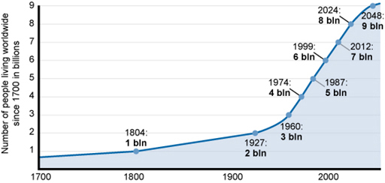
3. What trends can be observed in the relationship between agricultural production and population growth?
Implications:
The strong correlation between agricultural production and population growth underscores the critical role of agriculture in supporting global food security. However, the observed divergence in production trends post-2017 suggests potential overproduction risks or evolving consumption patterns that may require careful management to avoid resource wastage.
In researching history we realize prior to 1960 our population growth was at a flat line almost till the baby boomer 60's (which coincidentally was when our actual data set started). Maybe the sign of recent down trending AG Production could possibly correlate w a Population flat line to come.
***As global population growth is expected to slow in the coming decades, future agricultural strategies will need to pivot towards enhancing sustainability, reducing environmental impacts, and optimizing resource use rather than merely scaling up production.

Slide 13
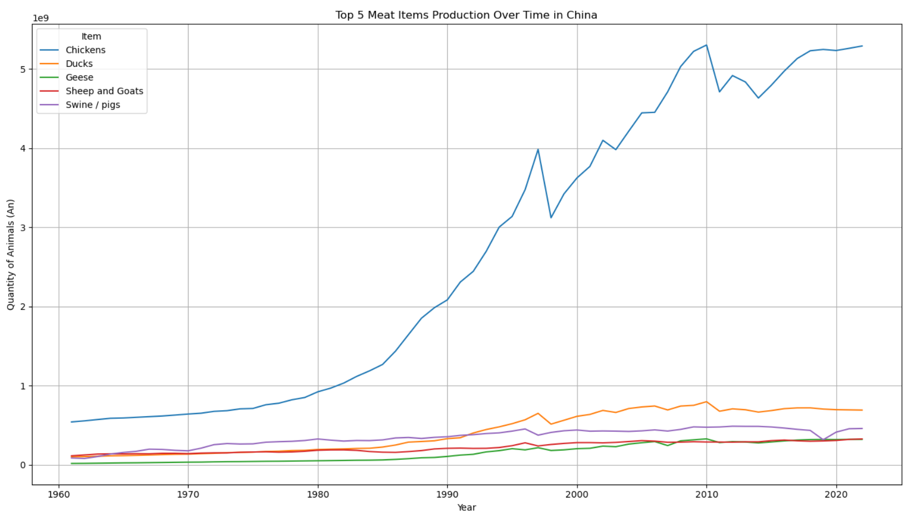
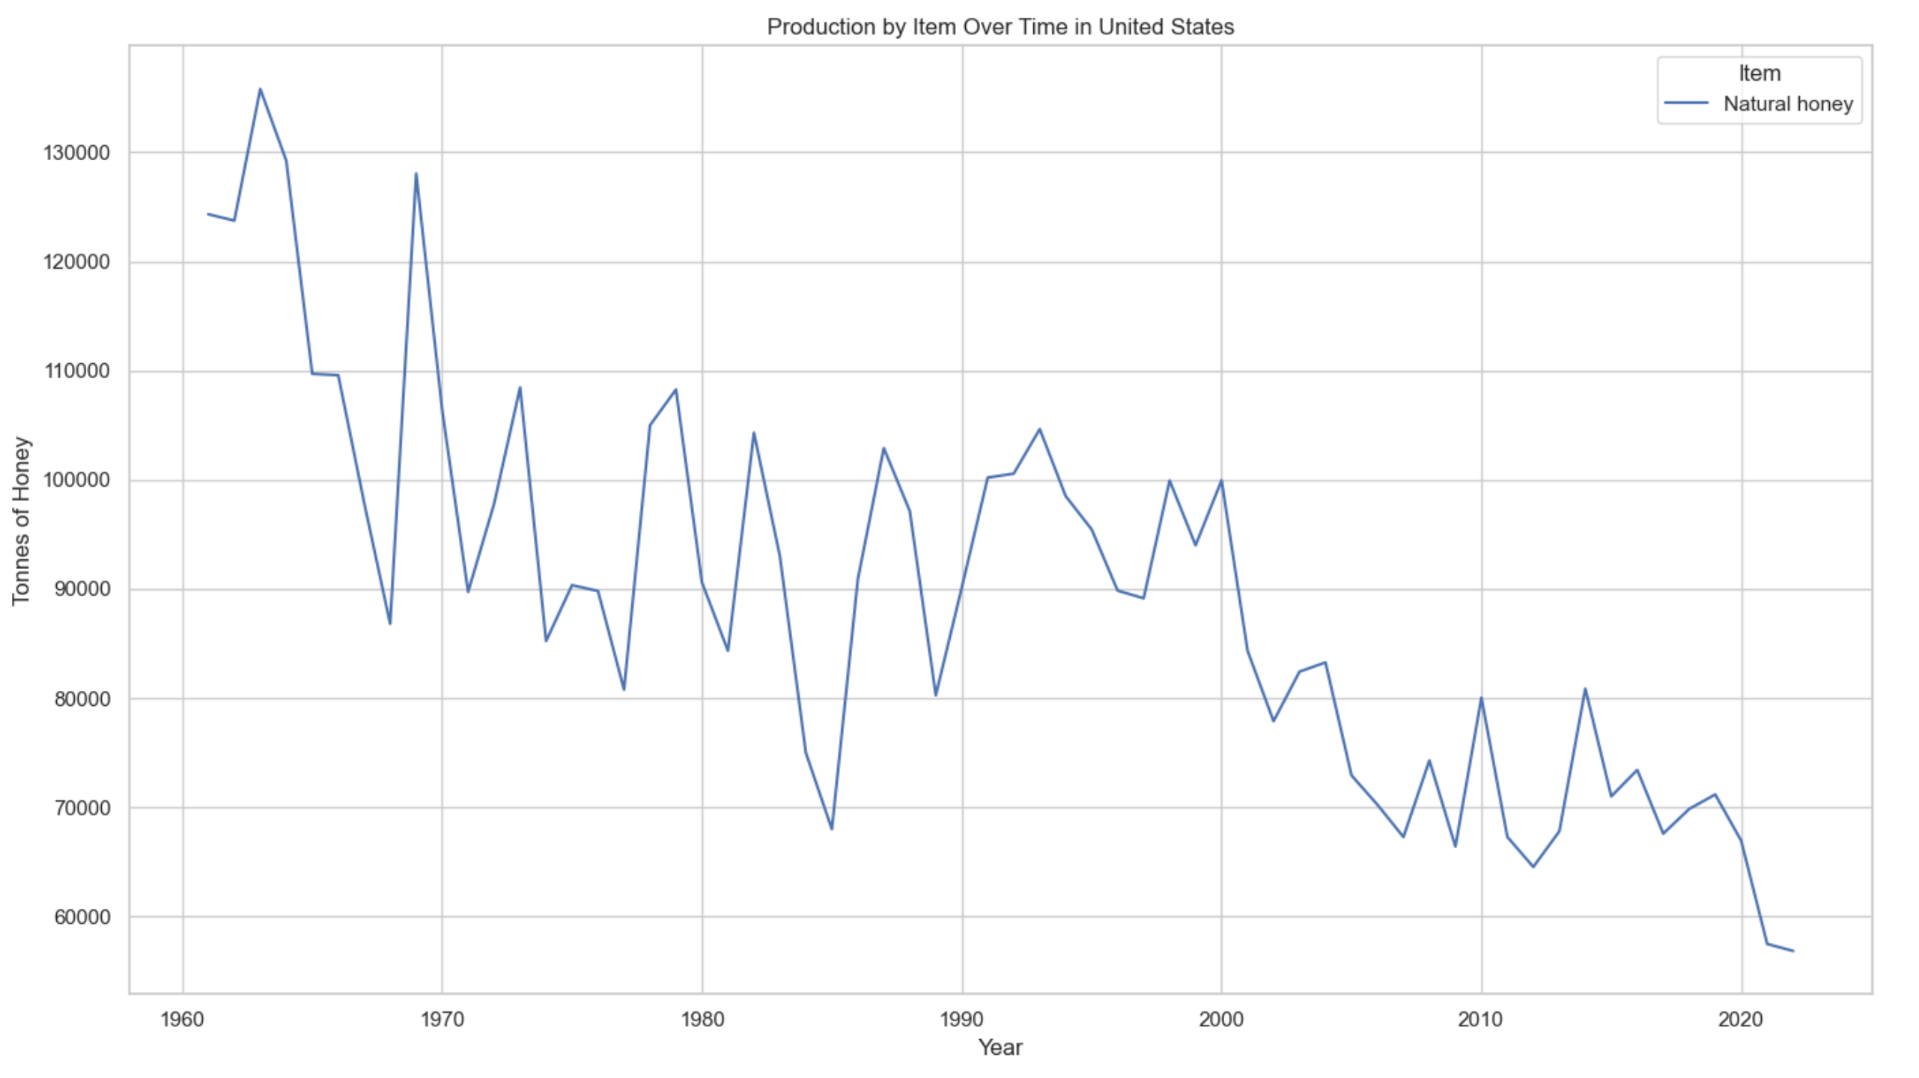
Additional Observations
Upon reviewing the data, several unexpected observations were made. First, North America only accounts for 14.6% of global food supply. A decline in food production was noted in Europe, raising questions about the underlying causes. An intriguing finding was that chickens are the most produced animal in nearly every country analyzed. Additionally, the U.S. exhibited a significant decline in honey production, which may be linked to the increased use of processed sugars—a trend that appears unique to the U.S. based on preliminary manual observations. These findings prompt further investigation into whether this pattern is a global phenomenon or confined to specific regions.

Slide 14
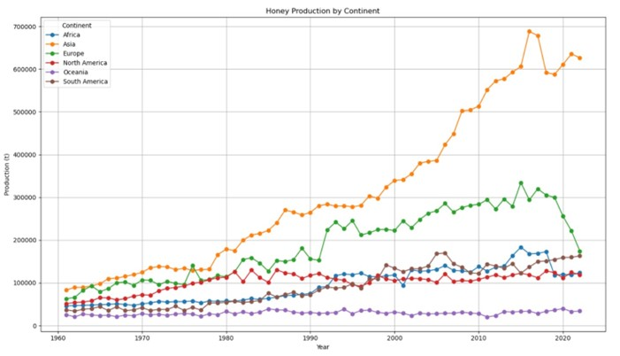
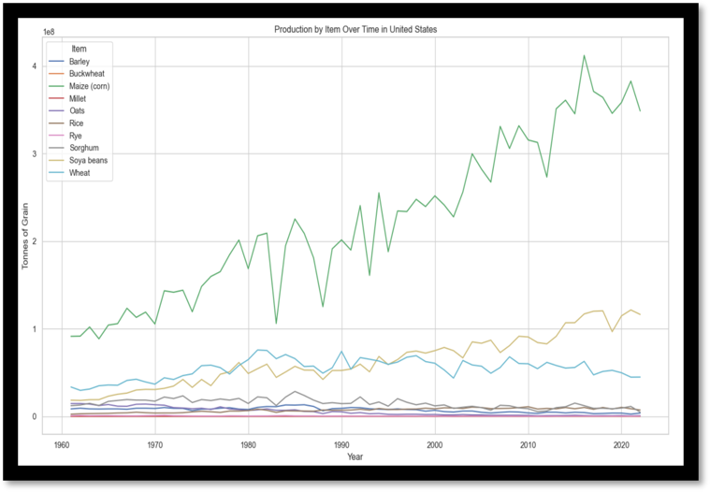
Future Development
Future development could focus on deeper analysis of honey production trends by country to determine if the observed decline is isolated to the U.S. or part of a broader global trend. Further exploration into the factors influencing corn production dips in the U.S. could also be prioritized, potentially examining climate data, such as drought occurrences. Expanding the data scope to include additional variables and investing in more time and resources for comprehensive analysis would be critical to uncovering the causes behind these observations.

Slide 15

Conclusion
The analysis reveals that global agricultural production is heavily influenced by regional factors such as climate, technological advancements, and cultural dietary preferences. While meat, particularly chicken production is dominant across all continents, other agricultural outputs vary significantly, reflecting the unique environmental and economic conditions of each region. Asia and North America lead in grain production, while South America’s main production is sugar. The concentration of production in a few key commodities, such as chicken, and staple grains, underscores both the strengths and vulnerabilities of the global food system. As population growth continues and environmental challenges intensify, there is a critical need for sustainable agricultural practices and policies that address these regional disparities and promote resilience in food production. Understanding these global and regional dynamics is essential for shaping future agricultural strategies that can ensure food security and adapt to changing global demands. We are not running out of food

Slide 16
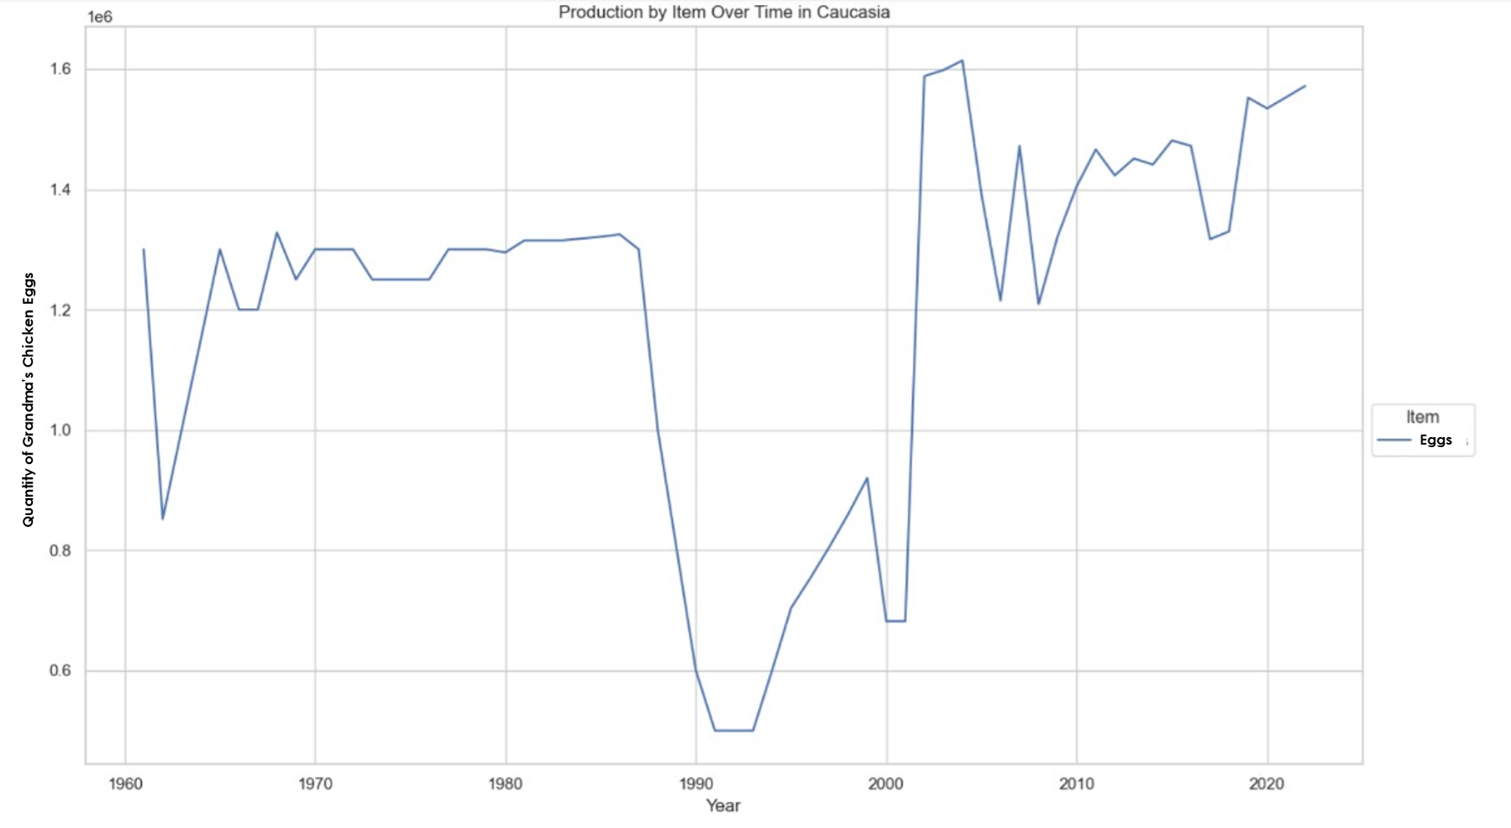



Extra Credit

